Slide 1
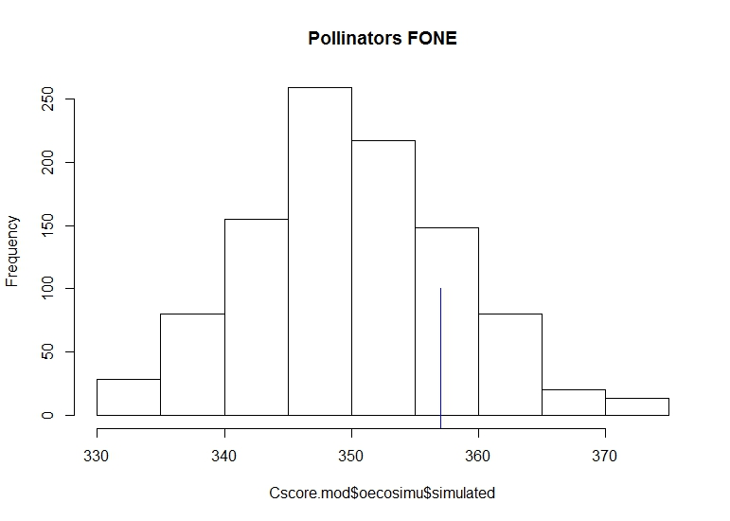
Checkerboard: Herbivores and Pollinators
Pollinator, F-1
Competition?
Herbivore) all tree types,
Obs. and expected similar.

Slide 2
Checkerboard: Decomposers
Decomposer, Narr.
Decomposer, F-1
Decomposer, BC
Decomposer, Fre.

Slide 3
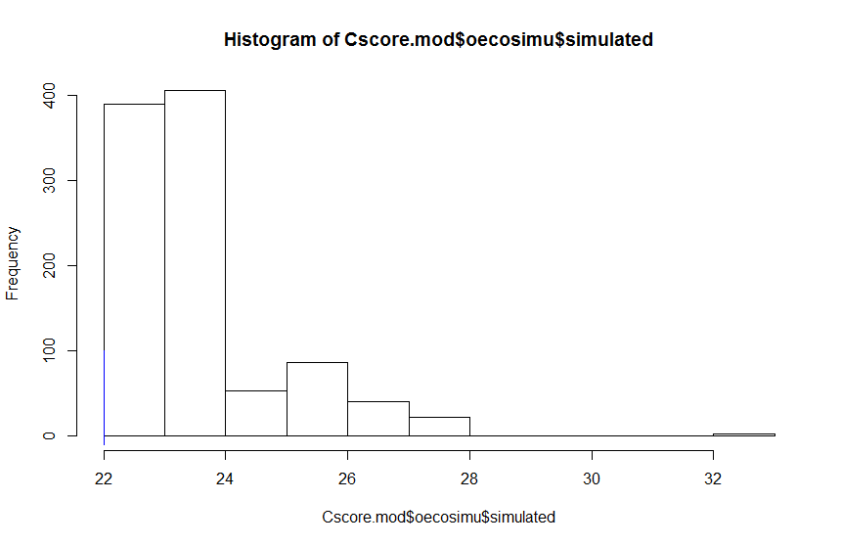
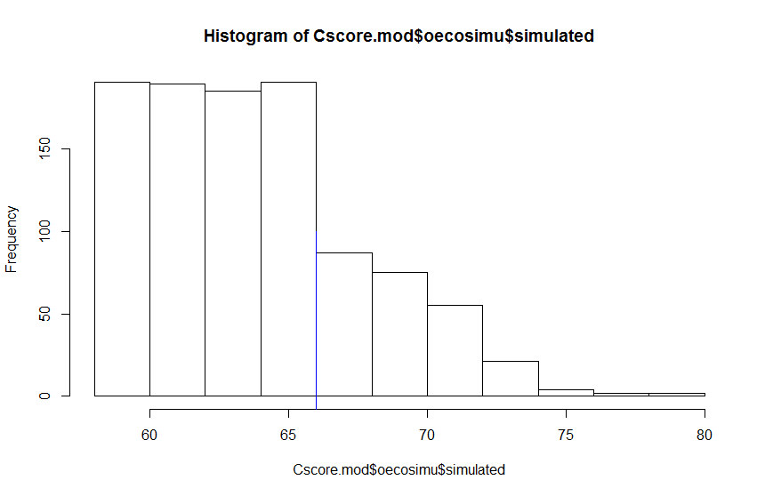
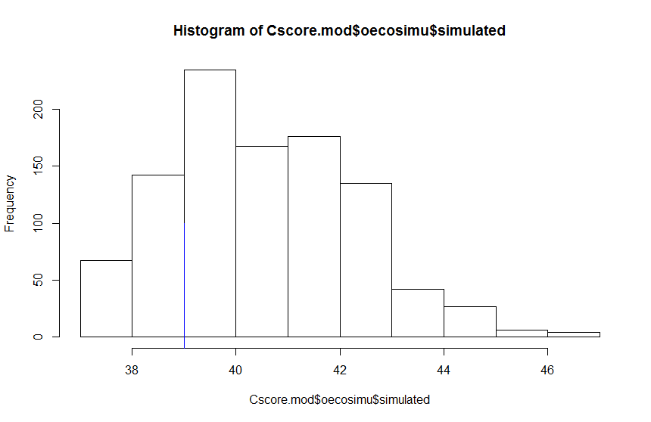
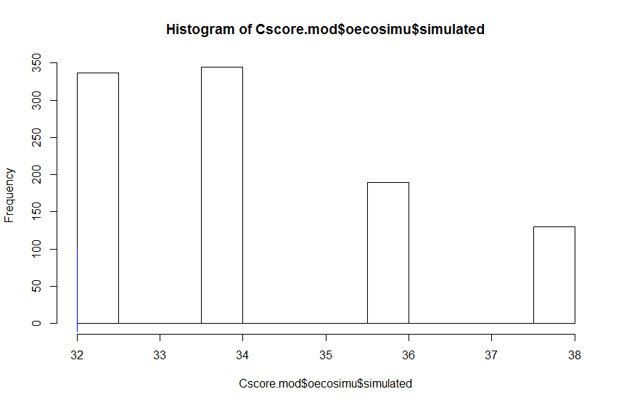
Checkerboard: Non-insects (spiders)
Non-insect, Narr.
Non-insect, F-1
Competition?
Non-insect, BC
Non-insect, Fre.

Slide 4
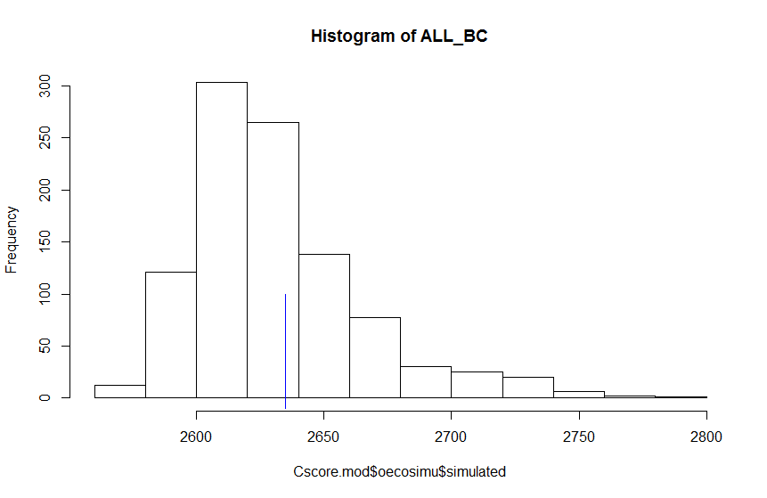
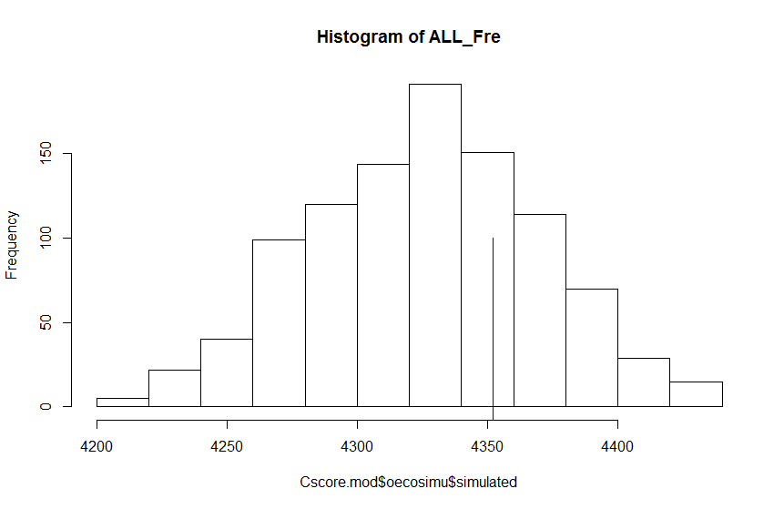
Checkerboard: All groups
All, BC
All, Fre.

Slide 5
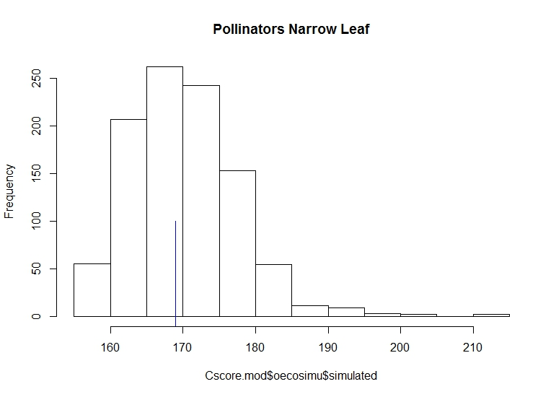
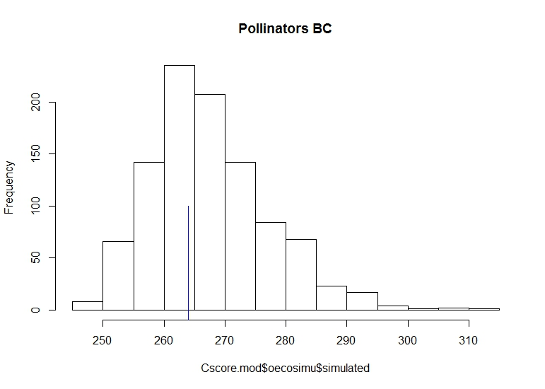
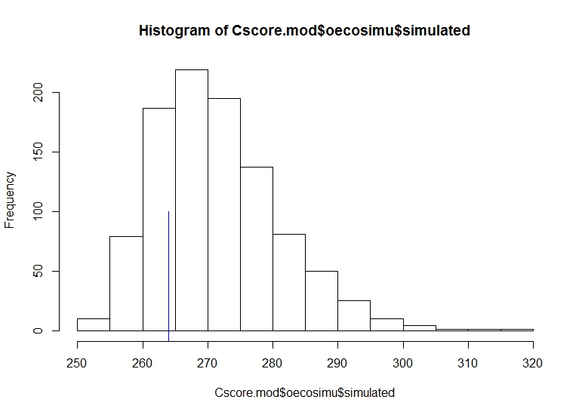
Pollinator, Narr.
Pollinator, F-1
Competition?
Pollinator, BC
Pollinator, Fre.

Slide 6
Decomposer, Narr.
Decomposer, F-1
Decomposer, BC
Decomposer, Fre.

Slide 7
Non-insect, Narr.
Non-insect, F-1
Competition?
Non-insect, BC
Non-insect, Fre.

Slide 8
Herbivore, Narr.
Herbivore, F-1
Herbivore, BC
Herbivore, Fre.

Slide 9
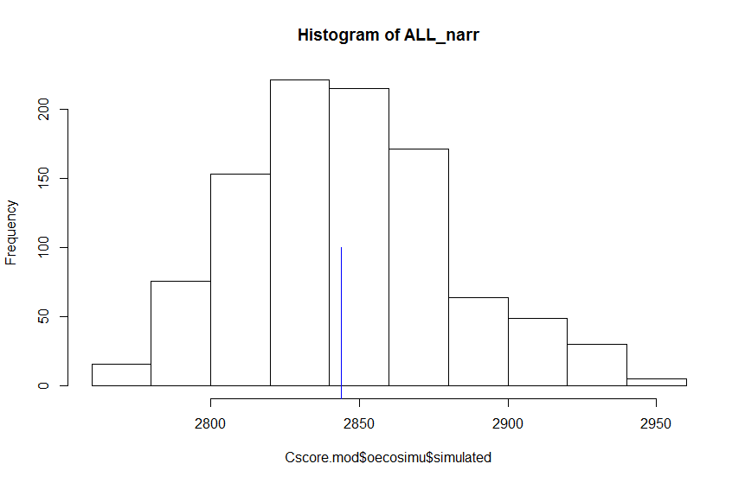
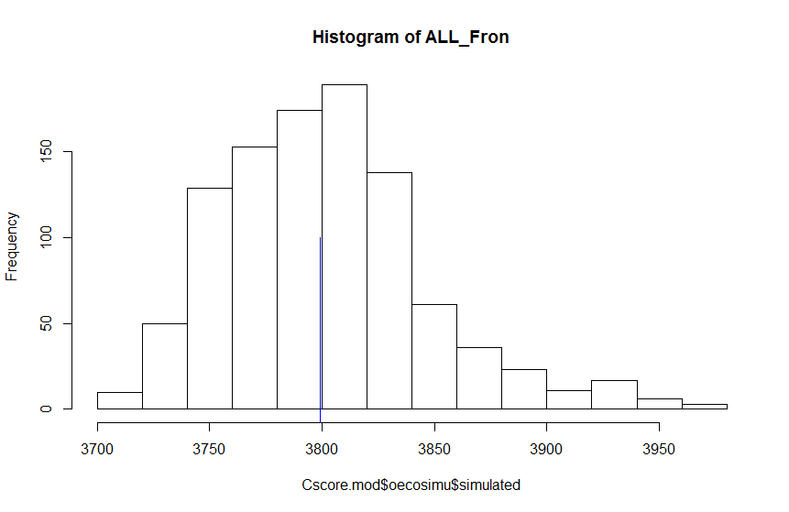
All, Narr.
All, F-1
All, BC
All, Fre.

Slide 13
Pollinator, Narr.
Pollinator, F-1
Pollinator, BC
Pollinator, Fre.

Slide 14
Decomposer, Narr.
Decomposer, F-1
Decomposer, BC
Decomposer, Fre.

Slide 15
Herbivore, Narr.
Herbivore, F-1
Herbivore, BC
Herbivore, Fre.

Slide 16
Non-insect, Narr.
Non-insect, F-1
Non-insect, BC
Non-insect, Fre.

Slide 17
All, Narr.
All, F-1
All, BC
All, Fre.

Slide 21
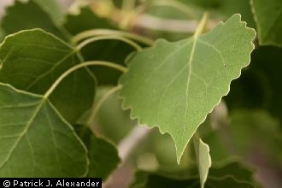

Slide 22
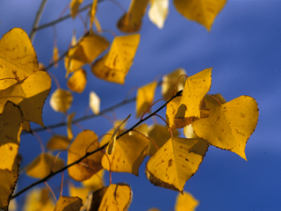

Slide 23
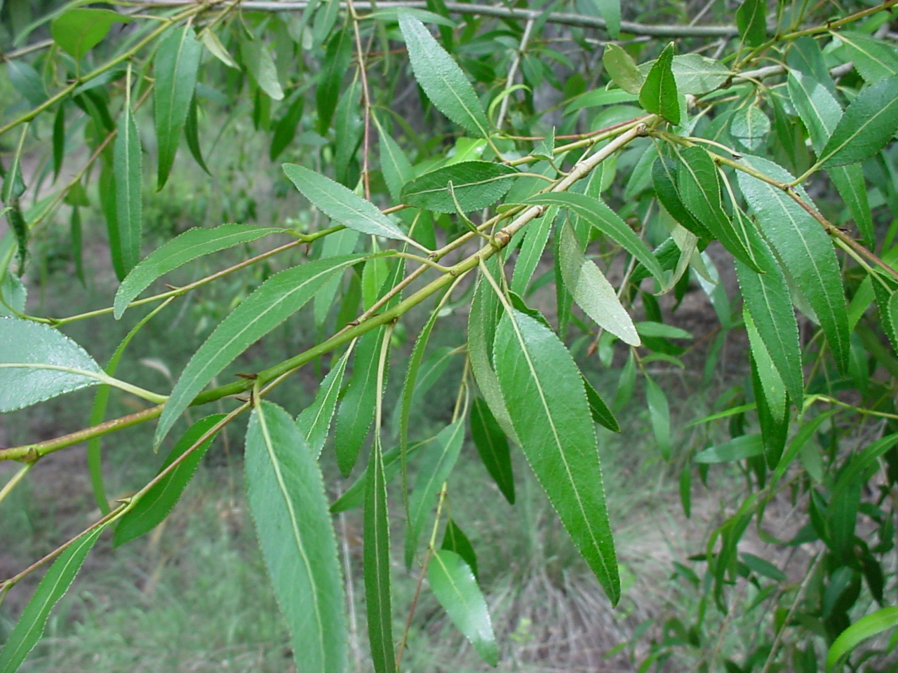

Slide 24
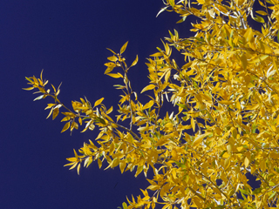

Slide 25
